Slide 1
Major project in Python

Slide 2
TOPIC – House Price Prediction
About Dataset:
I have taken this dataset from Kaggle. This dataset contains 21613 observations and 21 variables. These features include number of bedrooms and bathrooms, squire feet of living area, number of floors, squire feet of basement and many other important factors. Here, the target variable is the price.

Slide 3
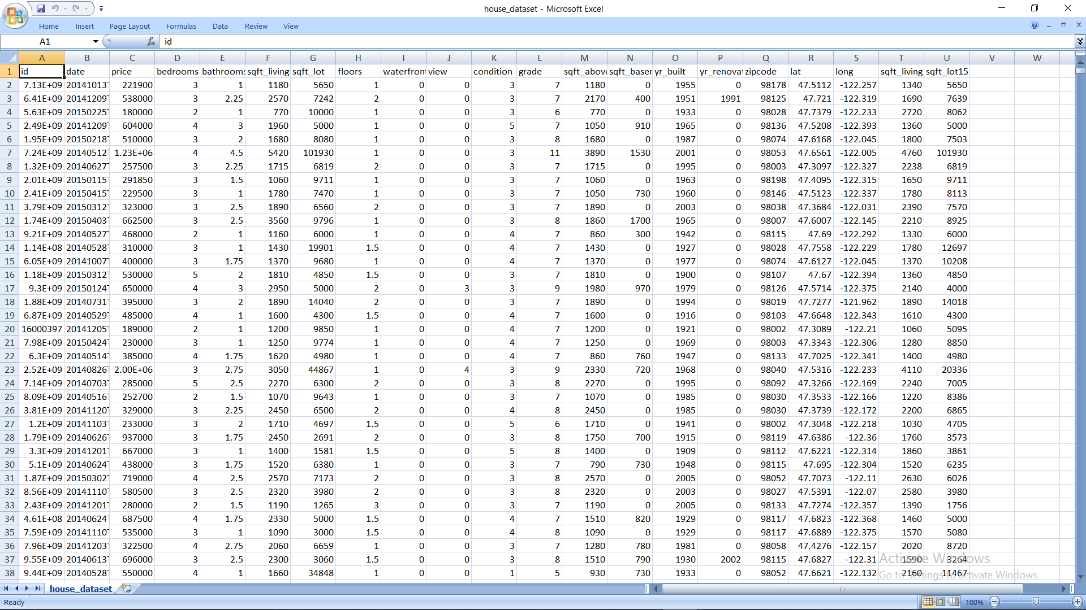

Slide 4
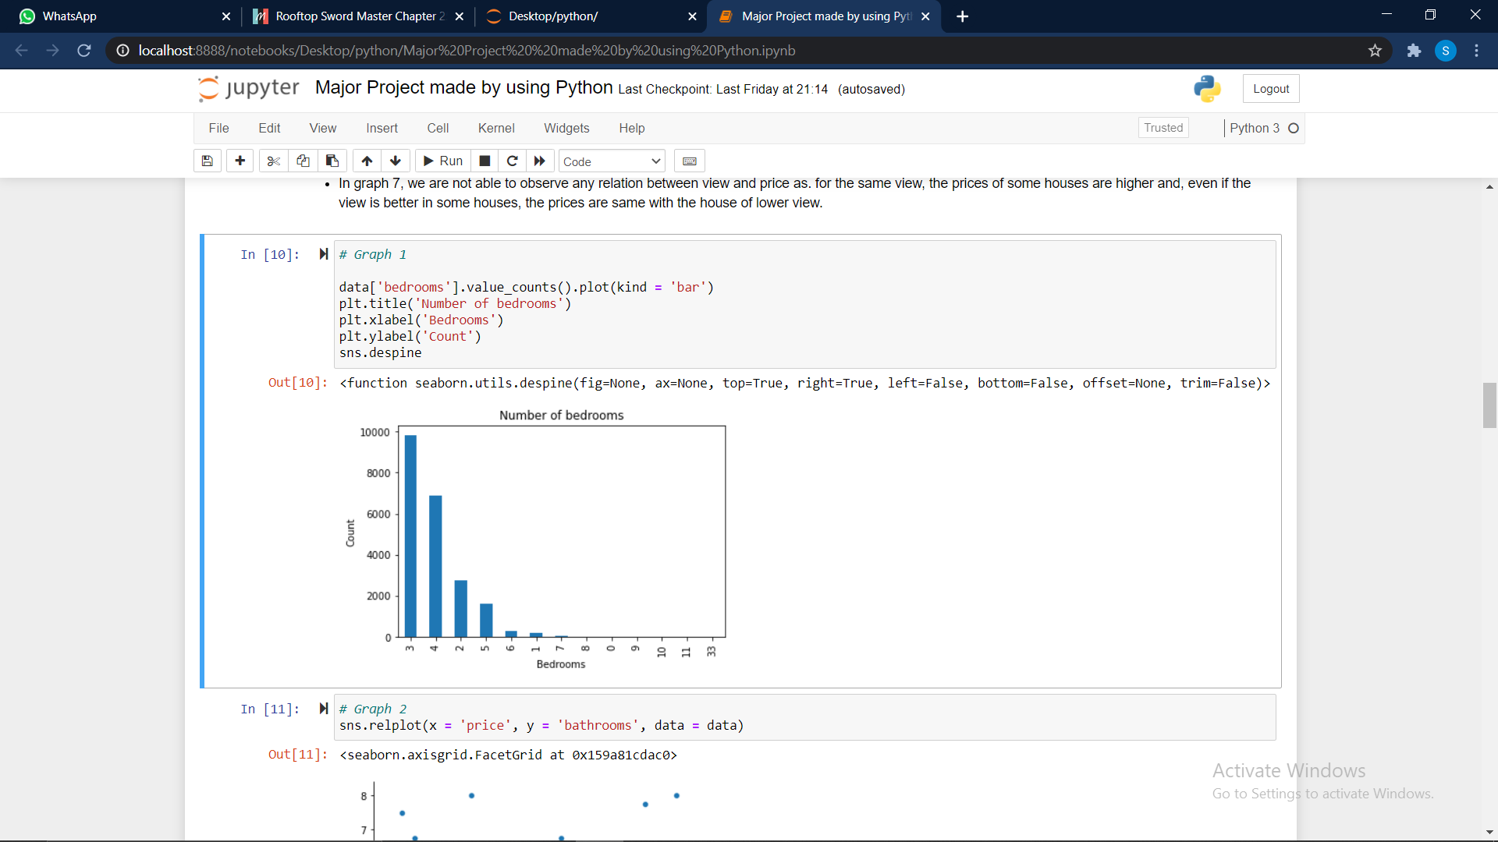
Visualization
Graph 1:
We can see that the count of houses with 3 bedrooms is the highest, followed by 4 and then 2 bedrooms. This means that builders are building houses with 3 bedrooms, the most as they are sold more as compared to the rest in the market.

Slide 5
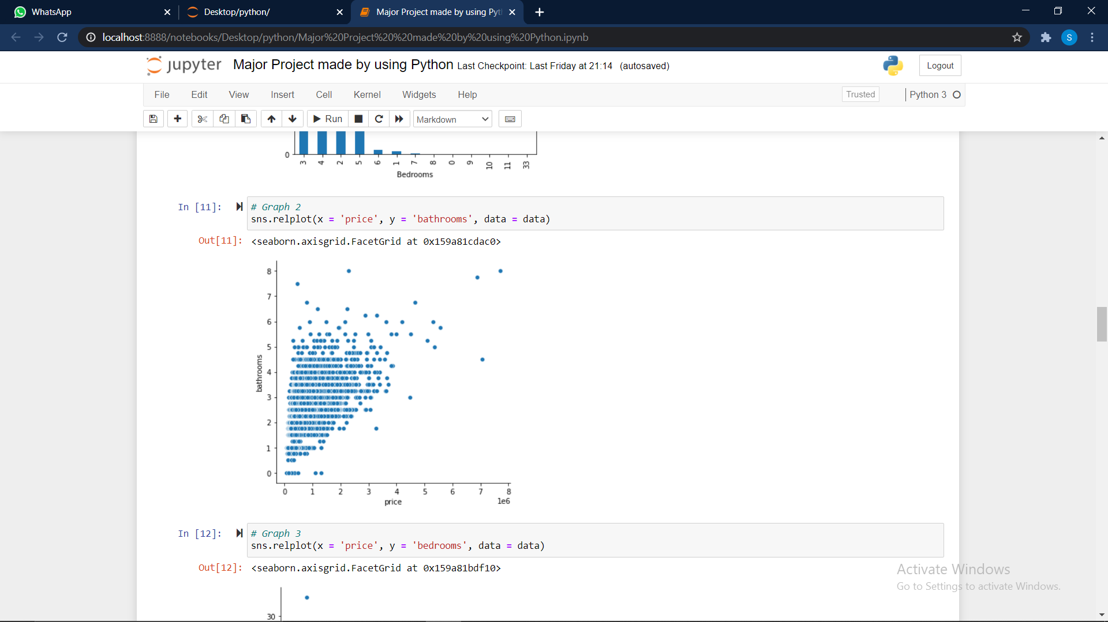
Graph 2:
We can observe that the price of the houses with bathrooms in the range from 1 to 5, does not fluctuate much and remain in the price bracket of 0 to 3, while there are some outliers.

Slide 6
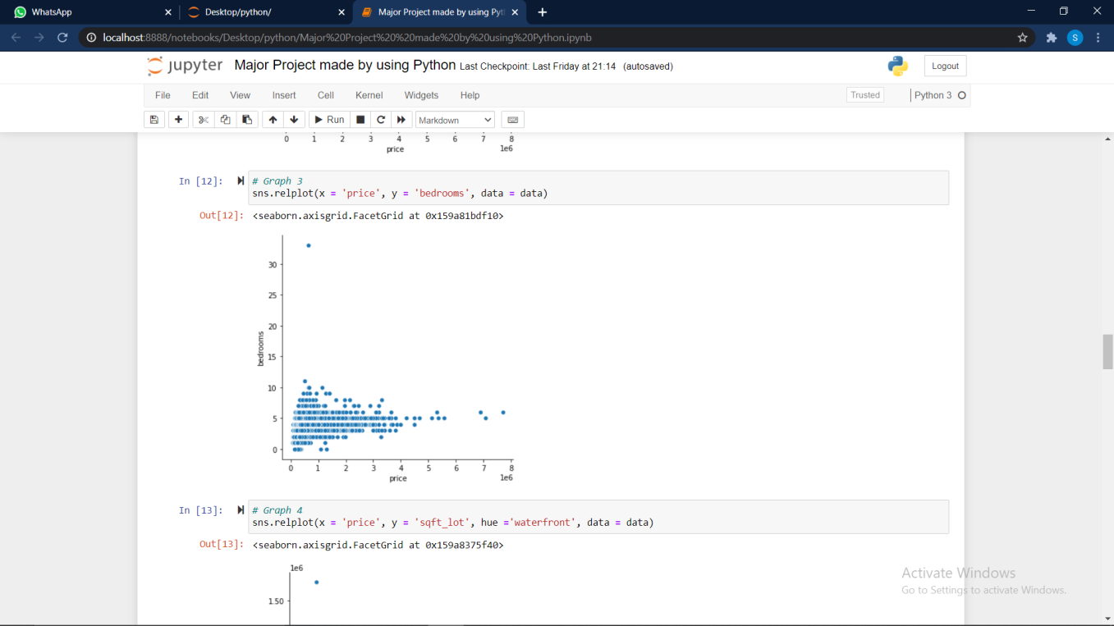
Graph -3
We can analyze that even if the number of bathrooms are same in houses, there prices vary much because of other factors, and hence there is no clear relation between price and the number of bedrooms.

Slide 7
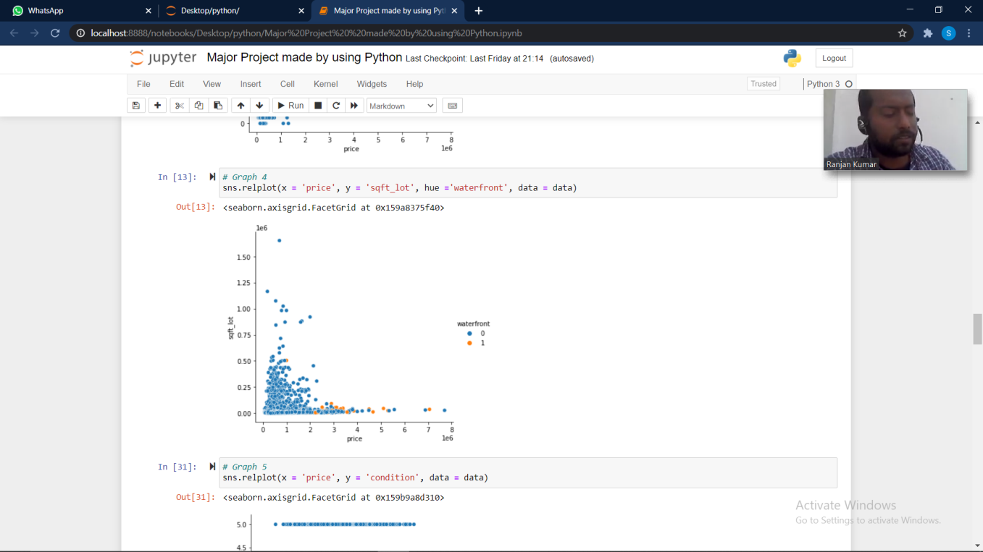
Graph 4 –
We can clearly see that the price of those houses are much higher then their counterparts with squire feet lot but are having a water front.

Slide 8
Algorithms Used
linear Regression: Linear regression algorithm shows a linear relationship between a dependent (y) and one or more independent (y) variables, hence called as linear regression. Since linear regression shows the linear relationship, which means it finds how the value of the dependent variable is changing according to the value of the independent variable.

Slide 9
Random Forest: It is based on the concept of ensemble learning, which is a process of combining multiple classifiers to solve a complex problem and to improve the performance of the model. Random Forest is a classifier that contains a number of decision trees on various subsets of the given dataset and takes the average to improve the predictive accuracy of that dataset.

Slide 10
Support Vector Machine: The objective of the support vector machine algorithm is to find a hyperplane in an N-dimensional space(N — the number of features) that distinctly classifies the data points. To separate the two classes of data points, there are many possible hyperplanes that could be chosen. Our objective is to find a plane that has the maximum margin, i.e the maximum distance between data points of both classes.

Slide 11
CONCLUSION
From the above observations, we can see that these 3 algorithms perform differently and there respective score also differs.
For Linear Regression, the accuracy is 77%.
For Random Forest, the accuracy is 88%.
For Support Vector Machine, the accuracy is 77%.
After Tuning the SVM, the accuracy is 88%.
Hence between these 3 models, the Random forest performed the best and after tuning, SVM performed similar.
​

